Slide 1
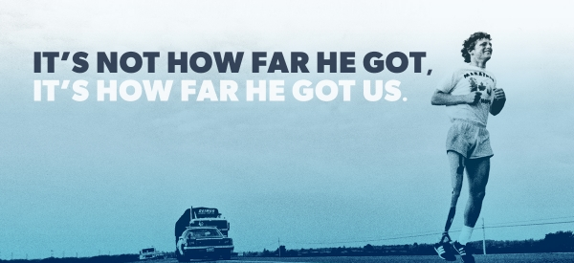
TERRY FOX
BY LYLA QUIBELL

Slide 2
WHY I THINK TERRY STANDS OUT IN CANADA
HIS DREAM WAS TO RUN ACROSS CANADA EVEN WITH AN ARTIFICIAL LEG.
ALSO TO RAISE MONEY FOR CANCER REASEARCH .
I THINK TERRY FOX REPRESENTS THE VALUES THAT ARE IMPORTANT TO ALL CANADIANS: courage, perseverance and selflessness.
HE IS RECOGNIZED AROUND THE WORLD AND IS A HERO TO PEOPLE ACROSS CANADA AND AROUND THE WORLD

Slide 3
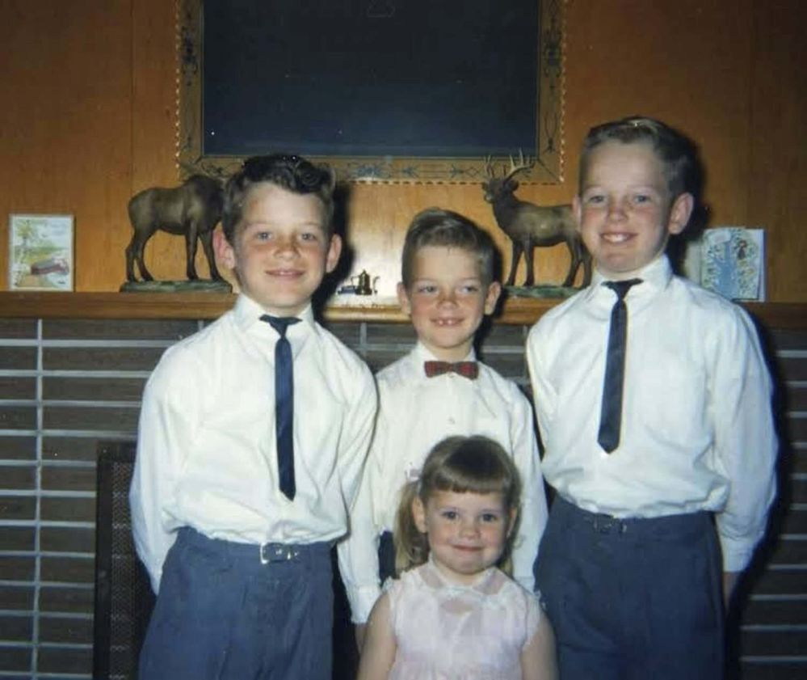
WHERE AND WHEN WAS TERRY BORN
TERRY WAS BORN......
TERRY WAS BORN IN....
JULY 28th, 1958
WINNIPEG, MANITOBA

Slide 4
BIOGRAPHY
Terrance Stanley (Terry) Fox, CC, OBC, athlete, humanitarian, cancer research activist. Terry Fox inspired the nation and the world through his courageous struggle against cancer and his determination to raise funds for cancer research.

Slide 5
Marathon of Hope
Not long after losing his right leg to cancer, he began training for his dream to raise money for cancer research by running across Canada.
He began his Marathon of Hope on April 12th, 1980 in St. John's Newfoundland.

Slide 6
Terry's Journey Across Canada
Terry ran in all kinds of weather and he crossed provinces and entered Ontario.
His best friend, Doug Alward, drove the van and helped Terry collect money for cancer research and organize the run.

Slide 7
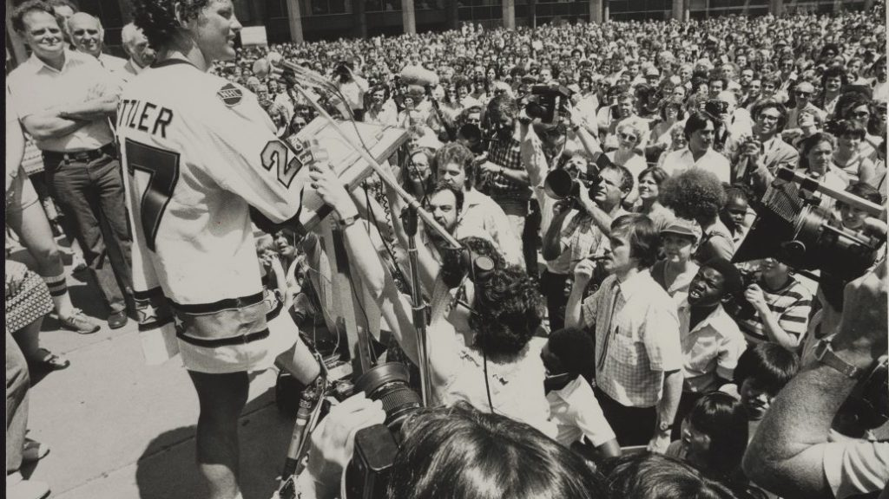
Raising Money
As he continued the run, his story continues to touch more people. More people hear about his run and come out in larger groups to give him more money for cancer research.

Slide 8
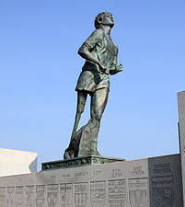
Thunder Bay
He ran close to 42 kilometres (26 miles) a day through Canada’s Atlantic provinces, Quebec and Ontario. However, on September 1st, after 143 days and 5,373 kilometres (3,339 miles), Terry was forced to stop running outside of Thunder Bay, Ontario because cancer had appeared in his lungs. An entire nation was stunned and saddened.

Slide 9
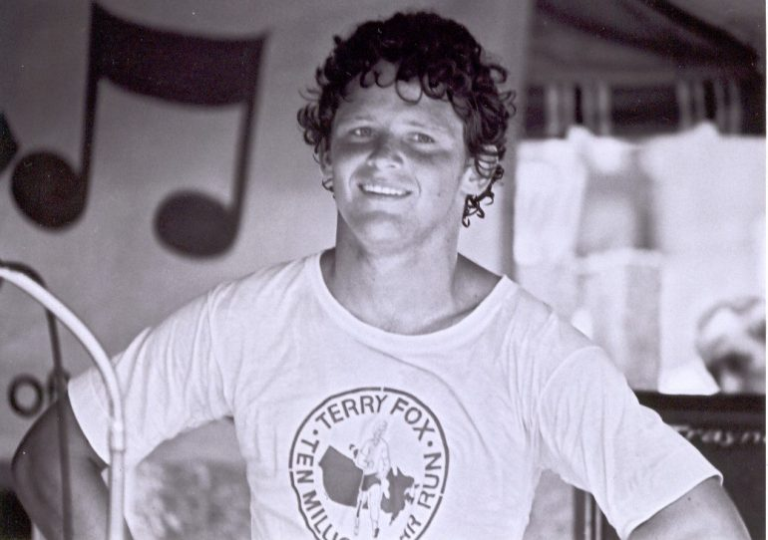
Legacy
His legacy is one of hope and courage; he proved that one person really can make a difference. Because of his Marathon of Hope, cancer survivors have benefitted from three decades of progress in cancer research.

Slide 10
TERRY SHOULD BE ON THE 5!

Slide 11
WHEN TERRY DIED
JUNE 28th, 1981
TERRY PASSED AWAY...

Slide 12
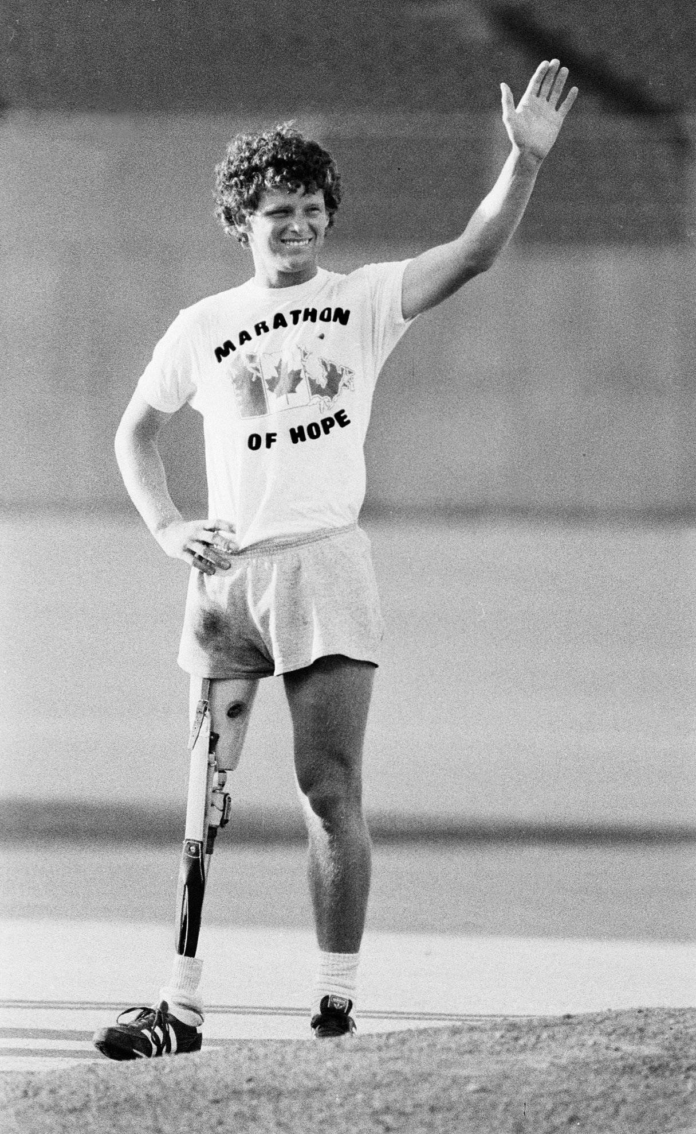
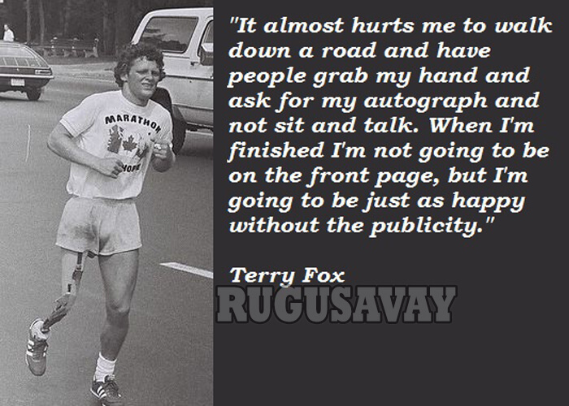
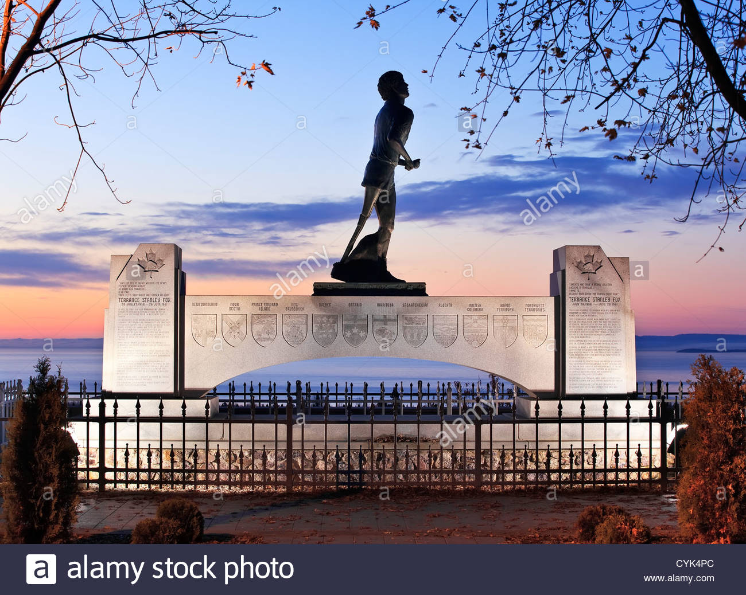

Slide 13
THE END

